Slide 1

Behaviour change communication for improved WASH practices through rural Health Facilities of Nepal
स्वच्छता
SWACHCHHATA
Improving quality of health care services
Mr Rajeev Banjara, MEL Advisor, Swachchhata

Slide 2
Swachchhata Introduction
5 districts – Dolpa, E. Rukum, W. Rukum, Jajarkot, Salyan
Purpose: To improve community health status by improved integration of hygiene in health service delivery
Results include:
  Functioning WASH infrastructure- 80 HFs
  Infection prevention and HW BCC-142 HFs.
  Improved WASH behavior change by community- 80 HFs

Slide 3
Demonstration of good WASH
Facility
IP practice
Community
Health Facility
Hygienic use of toilet
Handwashing with soap
Child feces management
MHM
Safe water
FCHV outreach to mothers groups→ BCC on 5 WASH behavior
Health Worker counselling of client→ PBCC on 5 WASH behavior
Notes:
Presentation focuses on PBCC and BCC (not of facility and IP)

Slide 4
BCC Planning Cycle
Formative
research
Communication objectives
BCC strategy - objectives, messages, channels
Develop (test) materials
Campaign implementation
Monitoring and evaluation
Audit of existing materials

Slide 5
I. Provider BCC (PBCC) for client counselling
Formative research on effectiveness of WASH counselling to clients
Behavior | Barrier | Motivator
Communicating five critical WASH messages to clients | High case load Lack of counseling room Lack of IEC material Unreceptive attitude of patients | Knowledge of WASH messages

Slide 6
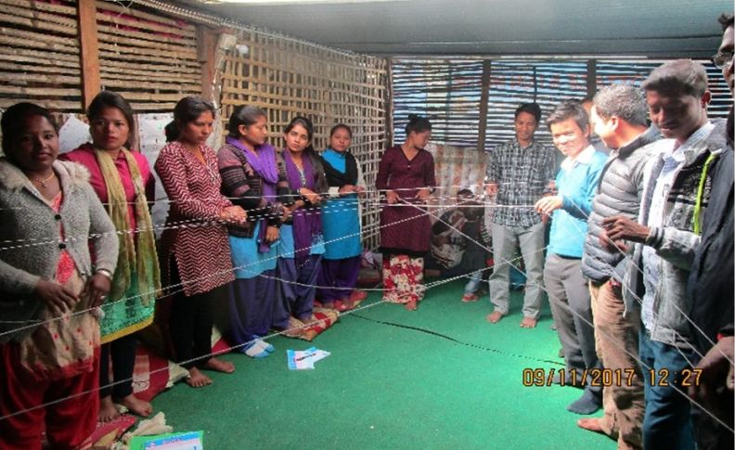
I. PBCC for client counselling
Developed training material on PBCC for Health Workers- NHEICC approval in process
Trained Health Workers in 142 HFs on client counselling

Slide 7
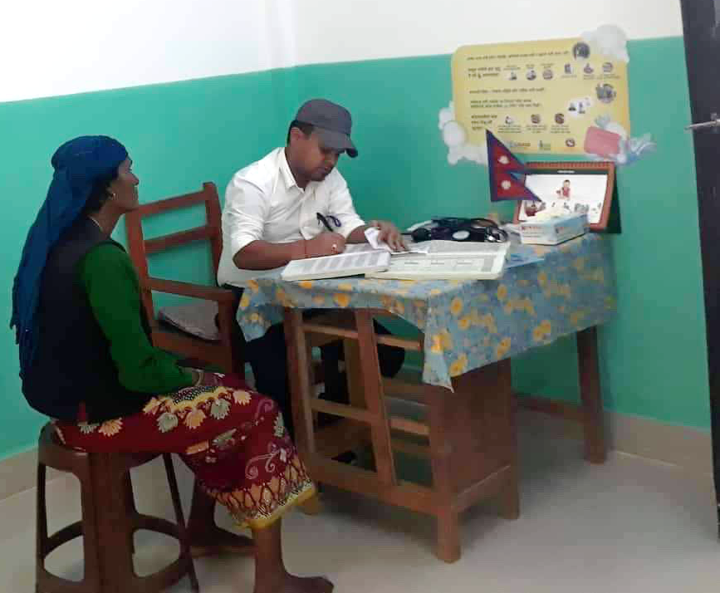
I. PBCC for client counselling
4) Developed/tested/and distributed “job aid” for client BCC to all HFs.
5) Monitoring of impact:
  Client exit interview
  Observation of counselling

Slide 8
% of HWs integrating WASH communication effectively in client counselling

Slide 9
% of clients understanding WASH messages after counselling

Slide 10
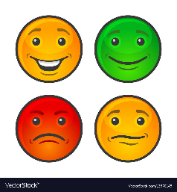


II. BCC for community outreach
Key baseline findings from household survey in communities.
96% of households are using an improved sanitation facility
74% of households are practicing safe disposal of child feces
54% of households have a hand washing with soap facility

Slide 11
II. BCC for community outreach
Formative research on barriers and motivators for adopting WASH behaviors by community.
Behavior (example) | Barrier | Motivator
Child feces management | Most consider the stool of infants fed on breast milk as harmless or at least less harmful than of adults because it is smaller, smells less, and contains less visual food residue No availability of materials i.e. plastic pot for child feces management in the local market. Insufficient water for cleaning child’s bum, flushing feces in to toilet | Appreciation by respected people in the community Disgust: Improper management can lead to feces being spread around the home and open area A child will be healthy and grow rapidly if feces is managed properly

Slide 12
II. BCC for outreach
Developed communication objectives and messages
Developed visual materials
4) Tested materials and updated for gender and social inclusion (including disabilities)

Slide 13
II. BCC for outreach
5) Campaign implementation going on:
  Training of Trainers to ANMs ➔
  Training of Facilitators to FCHVs ➔
  Implementation of BCC campaign in monthly mother group sessions (5)
6) Household self monitoring checklist
7) Impact monitoring on behavior change of households
  (these are not yet done)

Slide 14
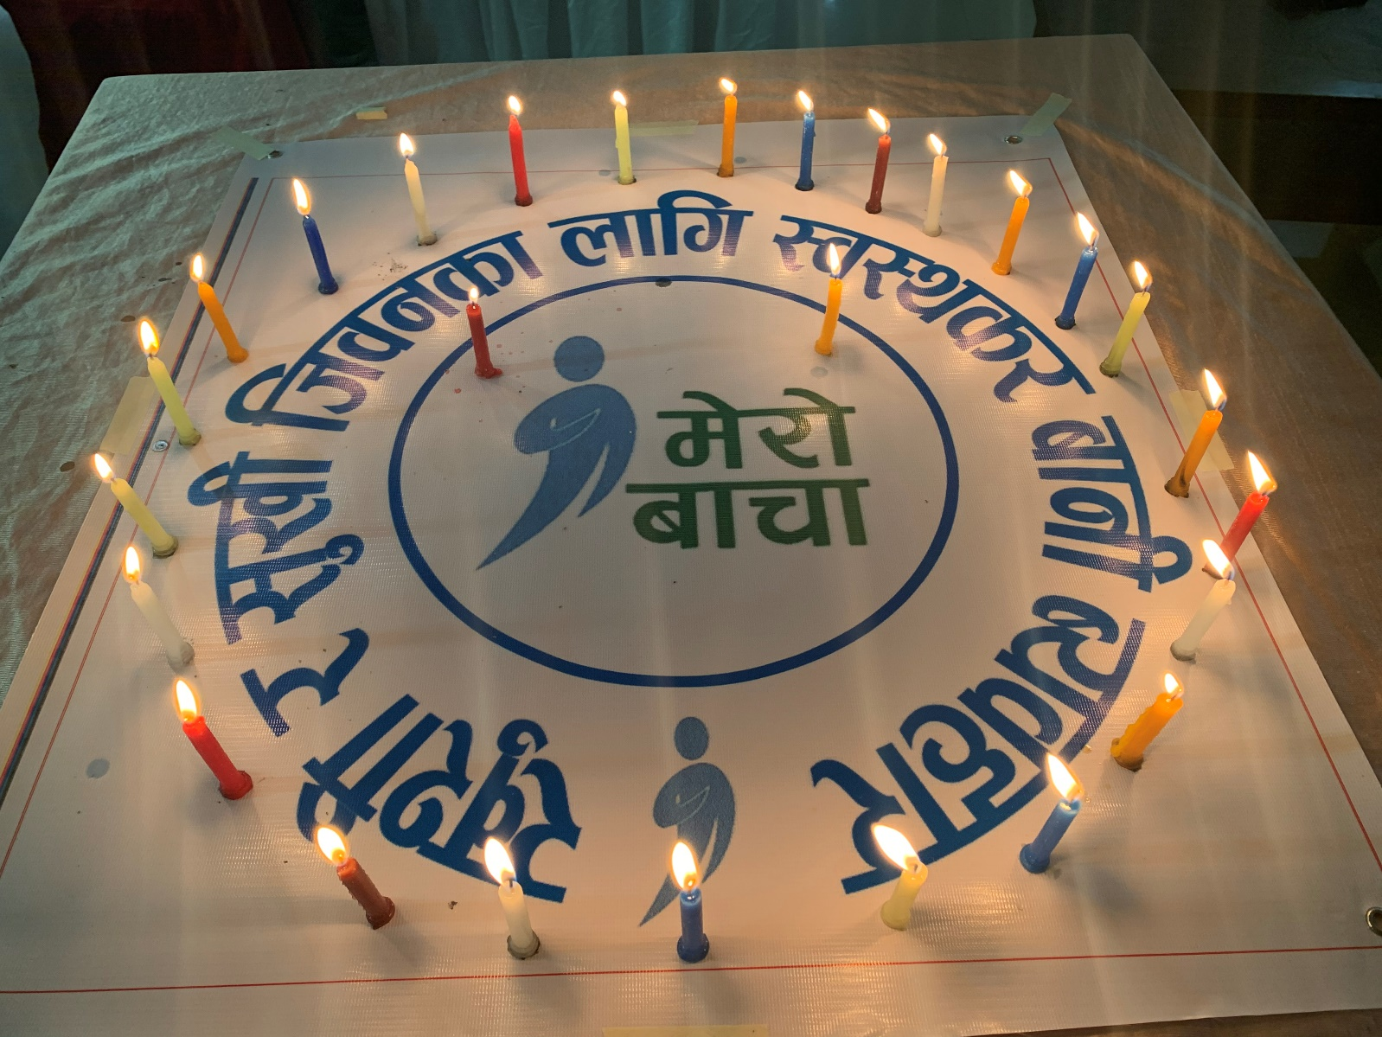
“Mairo Bacha”- commitment by all

Slide 15
Recommendations
Health Facilities provide a critical space for strengthening WASH behaviors – by demonstrating personal practice and counselling.
FCHVs link messages of Health Workers in Health Facilities to mothers groups in the community
The BCC cycle provides an effective way of assessing, designing, and implementing (P)BCC
“Mairo Bacha” BCC campaign links every individual with their commitment to improving WASH behavior

Slide 16
THANK YOU!

